Slide 1
DataNation

Slide 2
Team detail
Md Ehtesham Ansari (SRM University AP- Btech 2nd CSE)
Email:– mdehteshamansari00@gmail.com
Abhishikta Datta (SRM University AP- Btech 2nd CSE)
Email: - abhishikta_datta@srmap.edu.in

Slide 3
Adidas classification model
In this project we’ve analyzed the dataset of adidas and found some useful information like
Correlation between the features of the dataset
Selling Price Density
Most Expensive Category Of Product
Most Sold Category Of Product
Common Products
Average Selling Price Of the Categories
Average Rating Of The Categories
Highest Rated Products

Slide 4
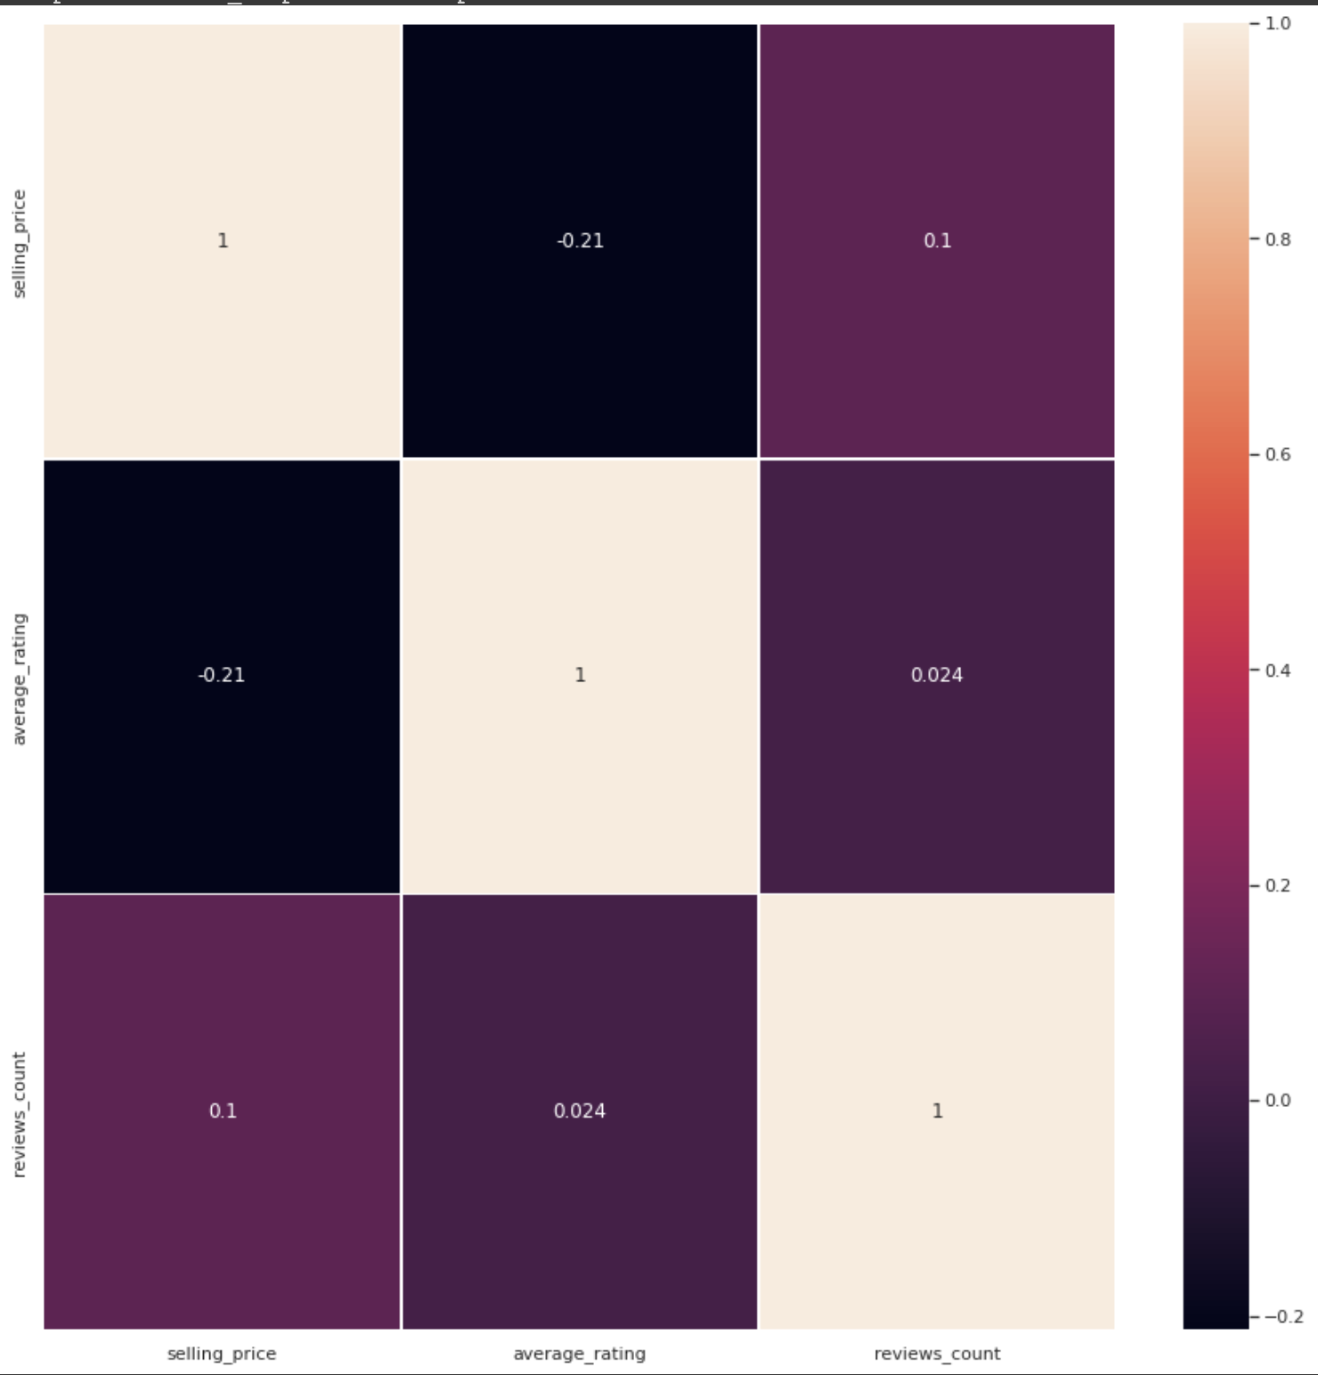
Heat MAp

Slide 5
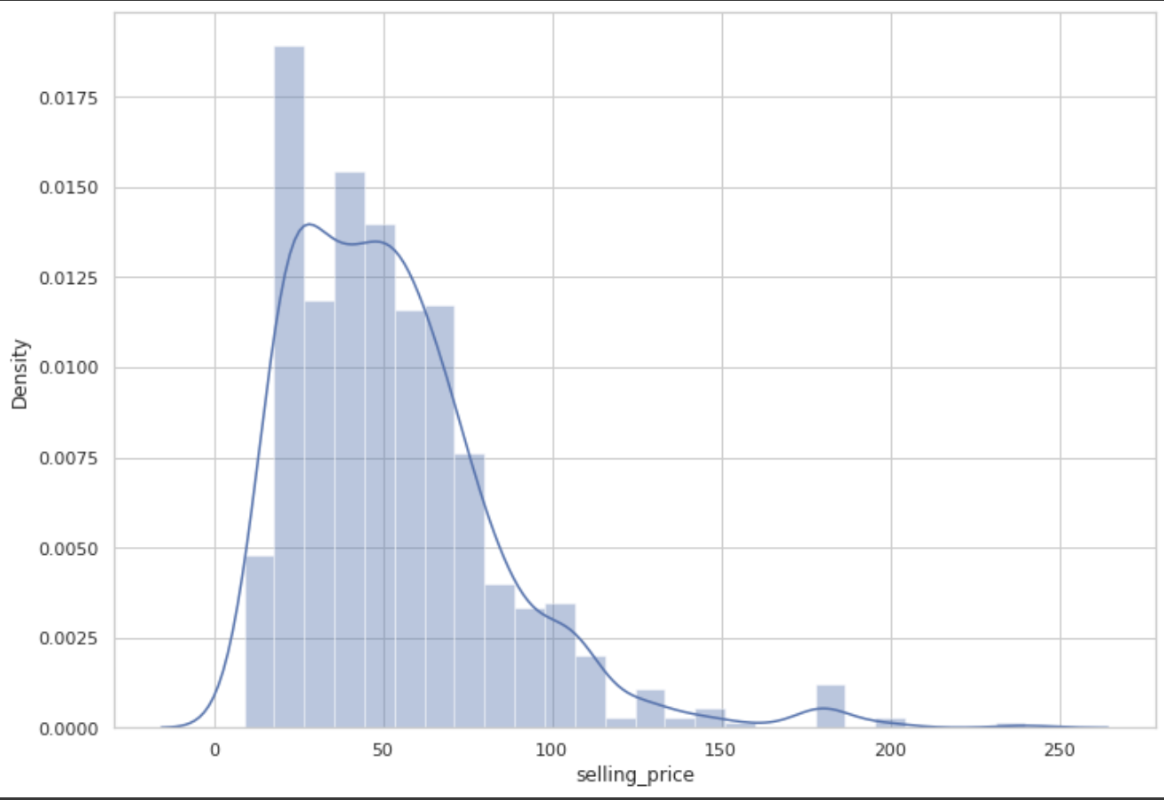
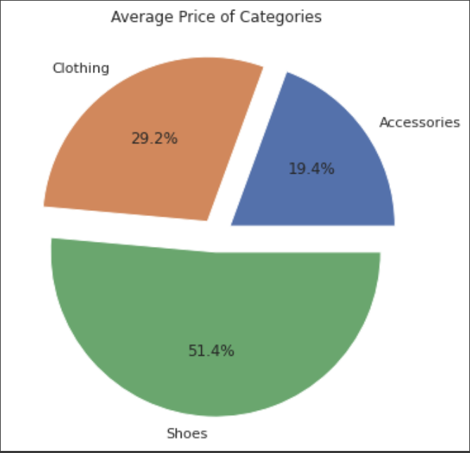
Selling Price density
Average Group price

Slide 6
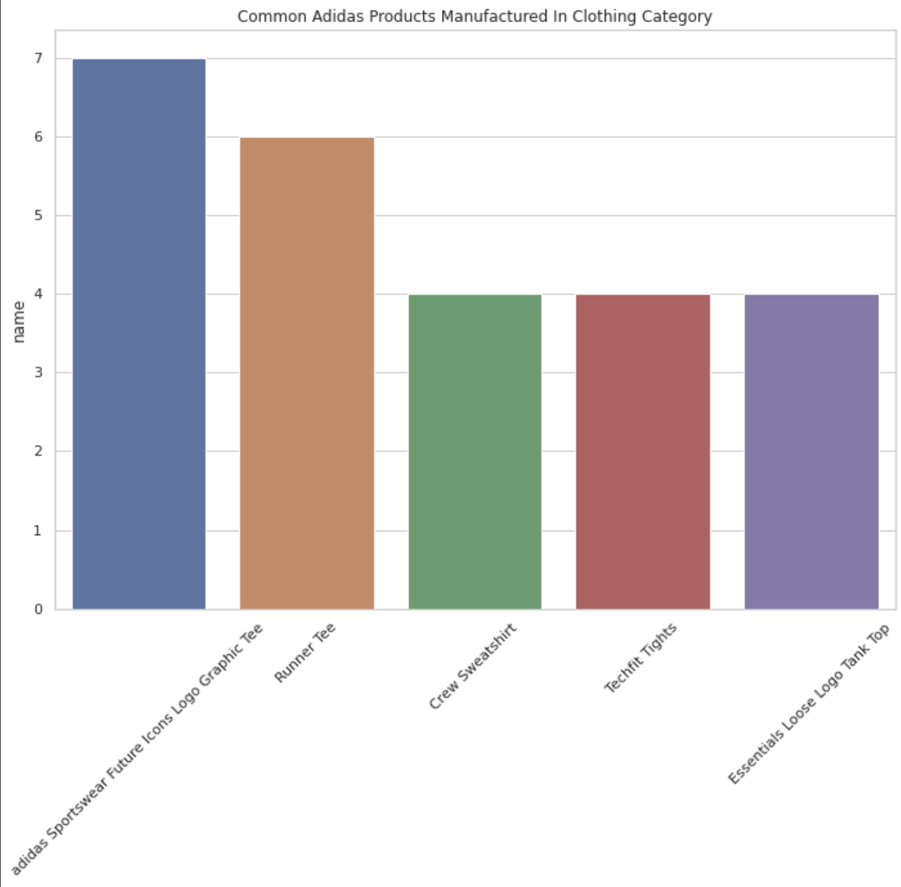
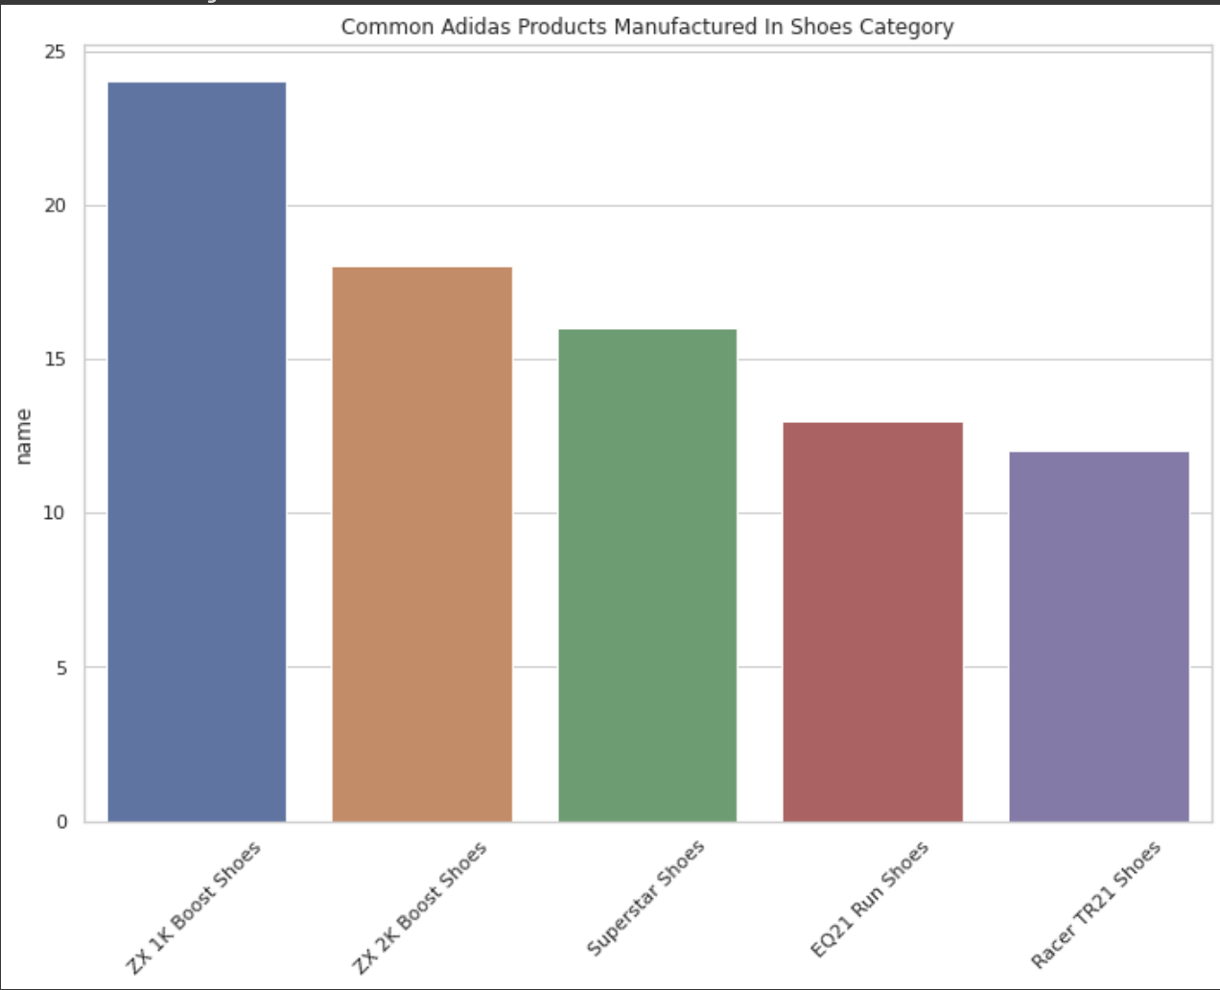
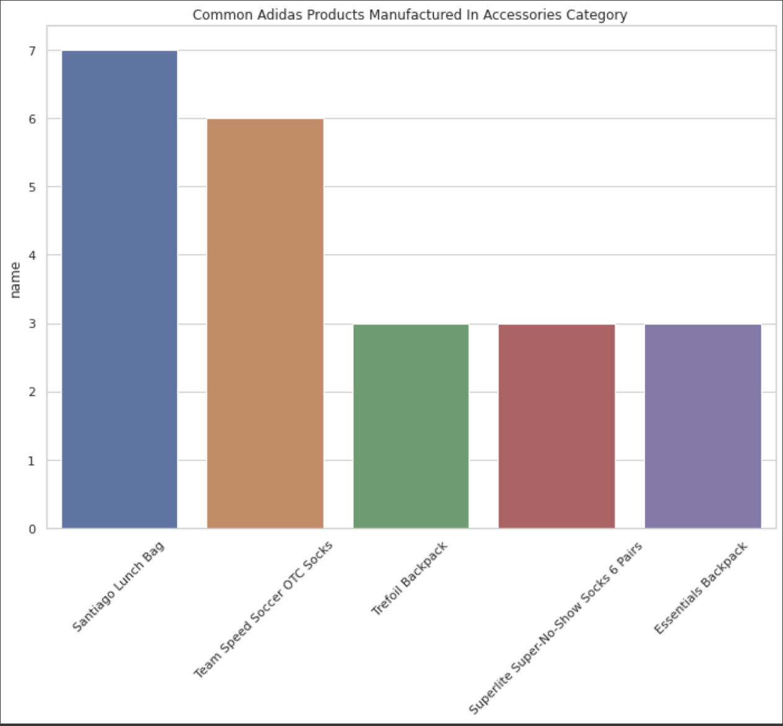
Common products

Slide 7
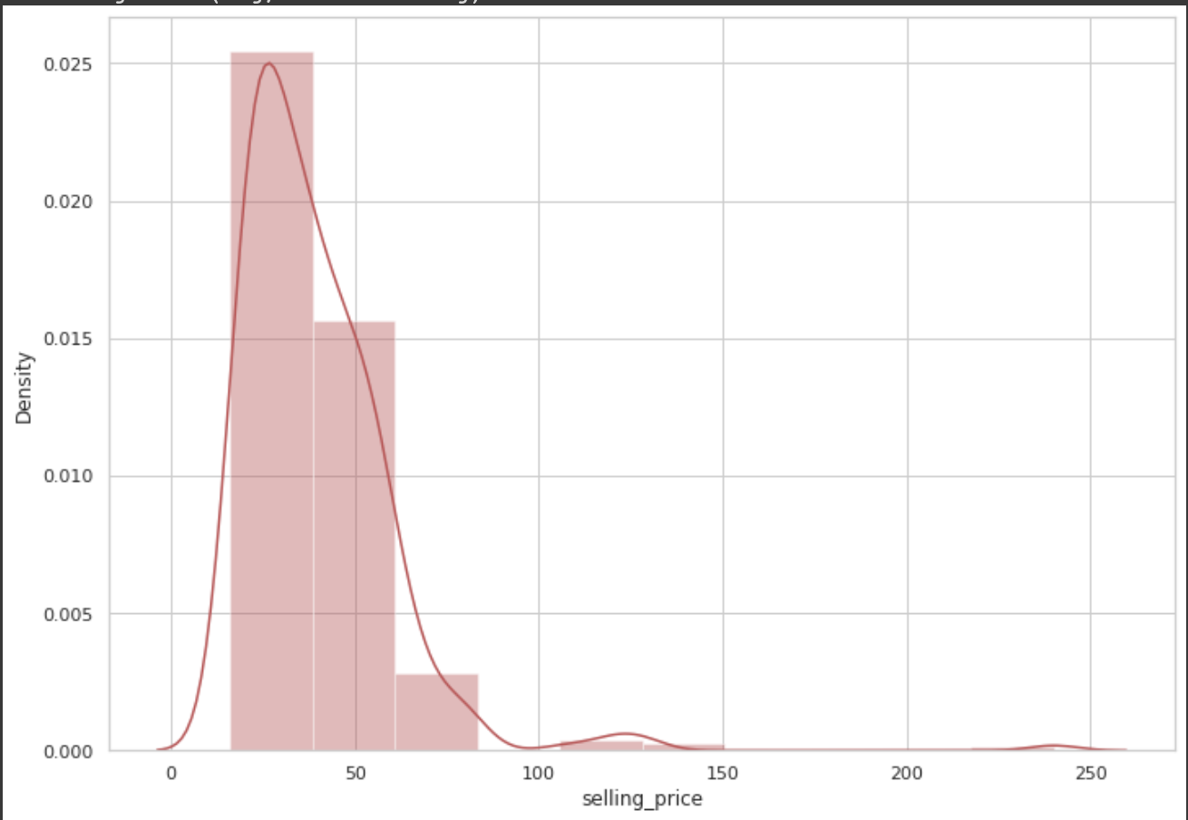
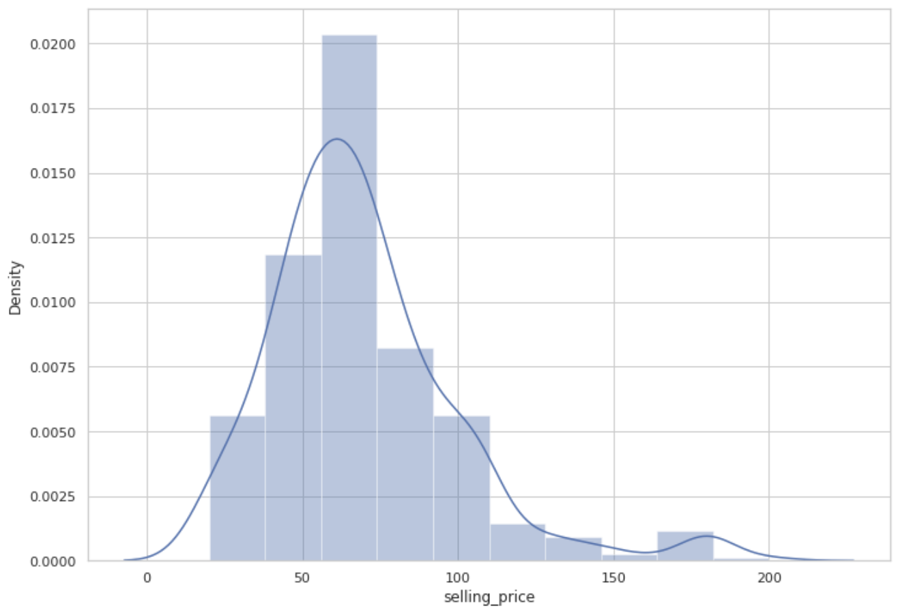
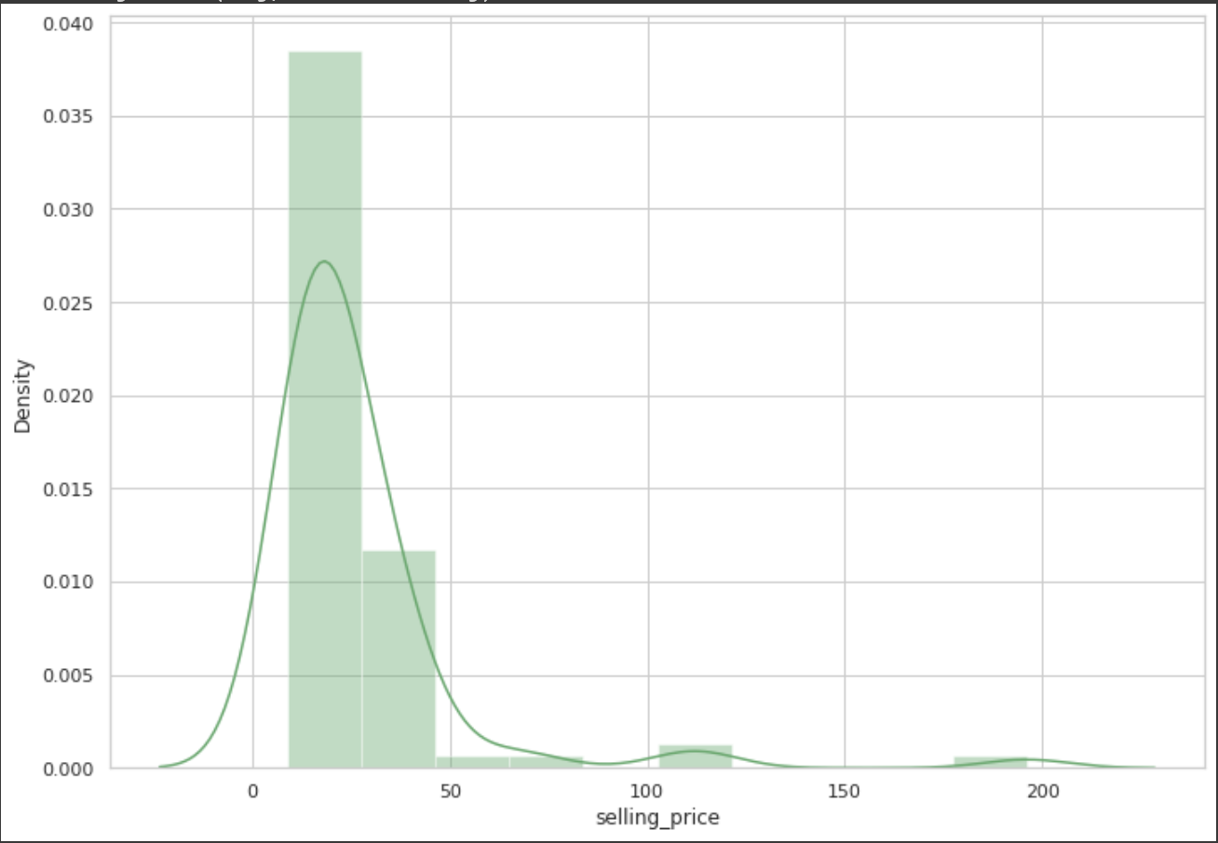
Average selling price
Clothing
Shoes accessories

Slide 8
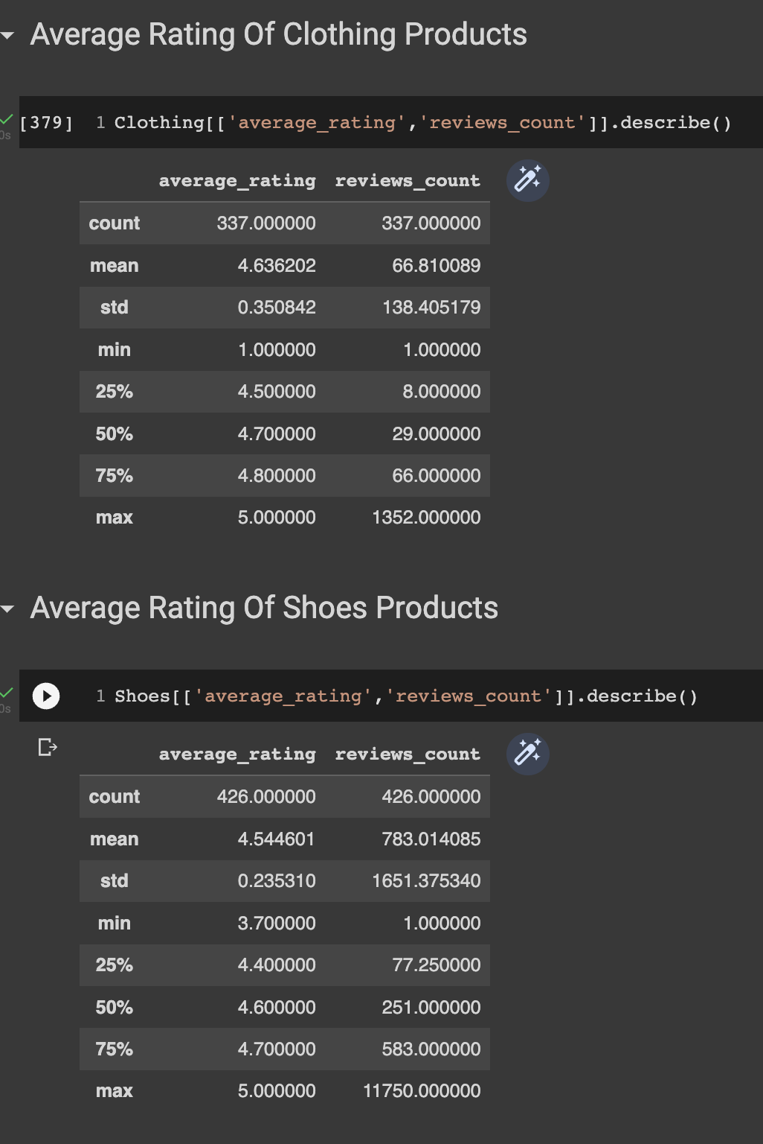
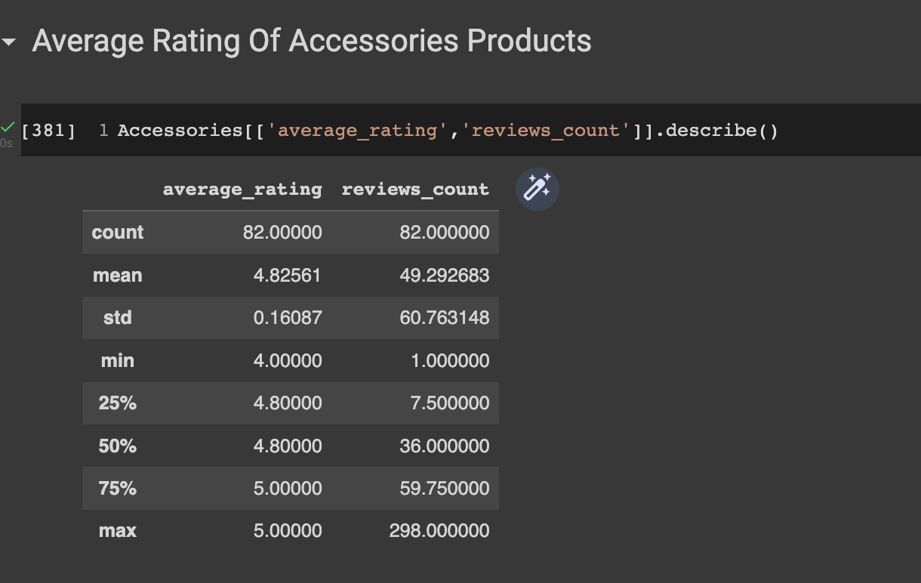
Average rating of the products

Slide 9
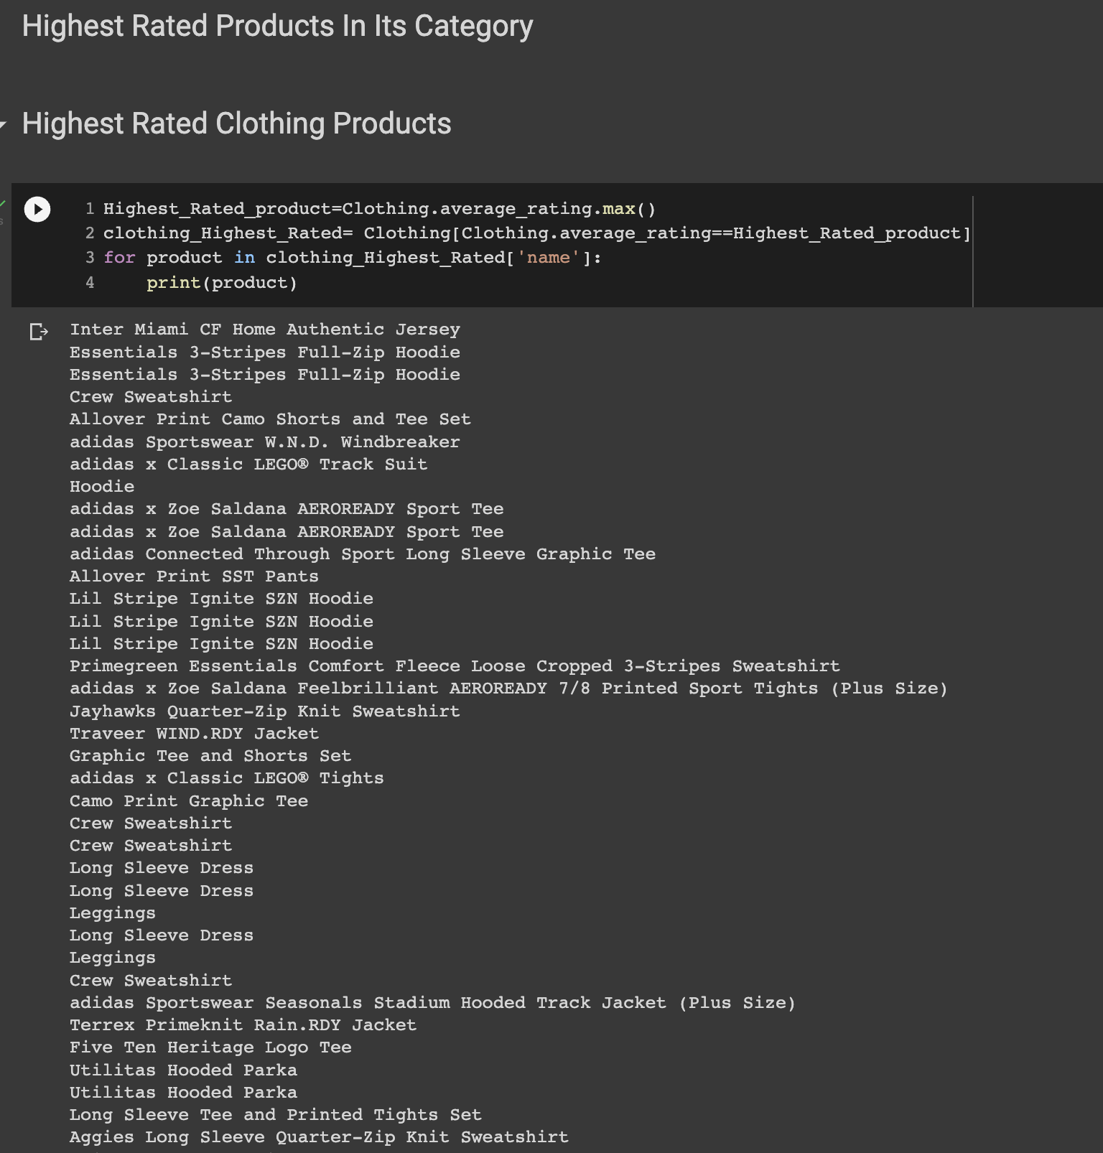
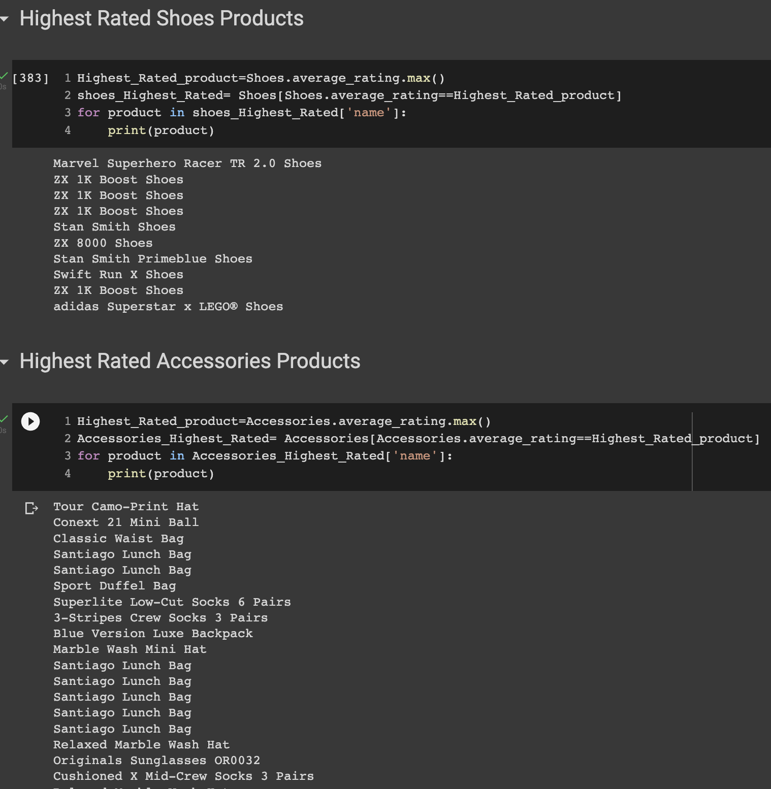
Highest rated products

Slide 10
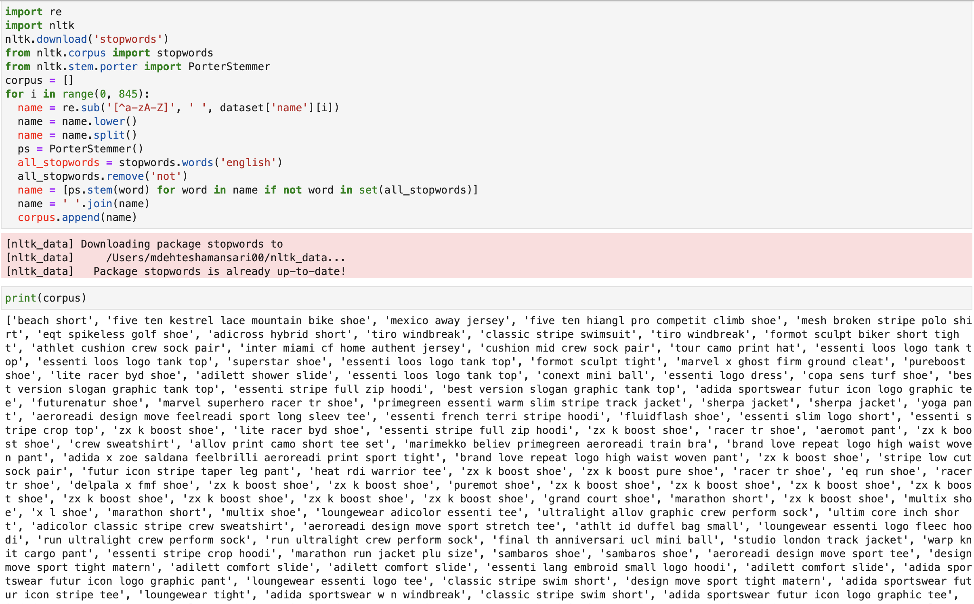
Cleaning the text

Slide 11
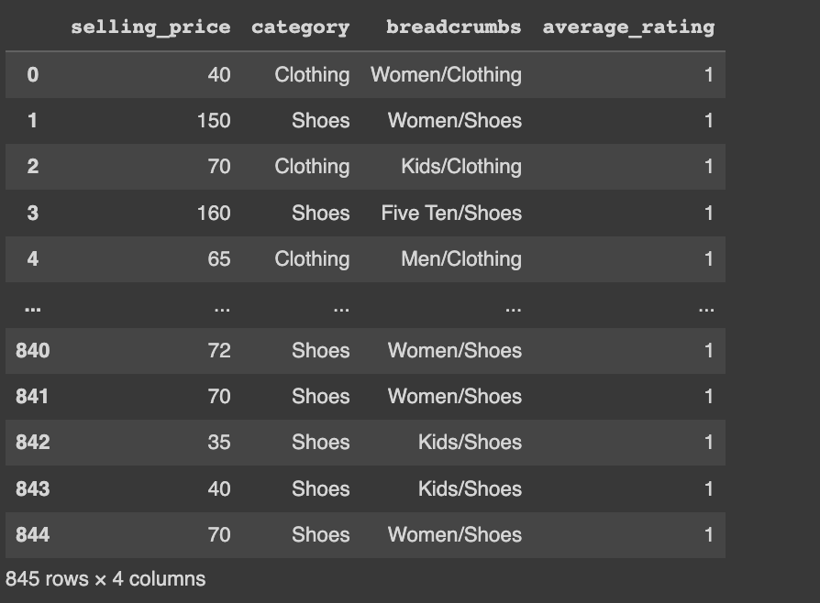
After dropping the unwanted features

Slide 12
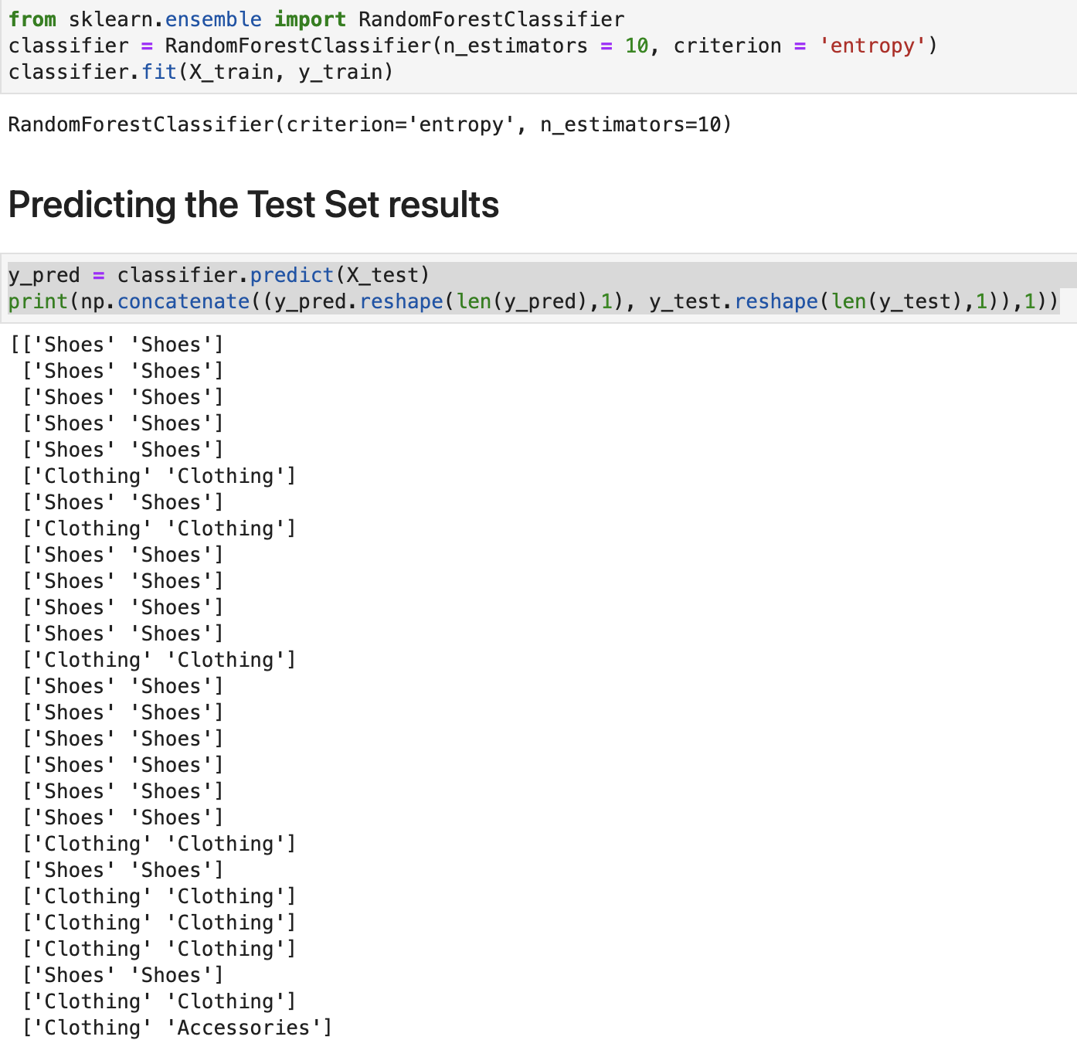
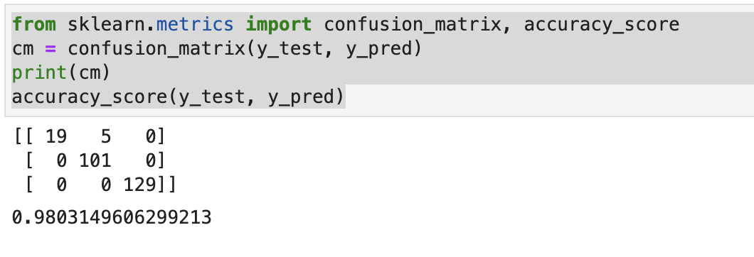
random forest model
Accuracy score

Slide 13
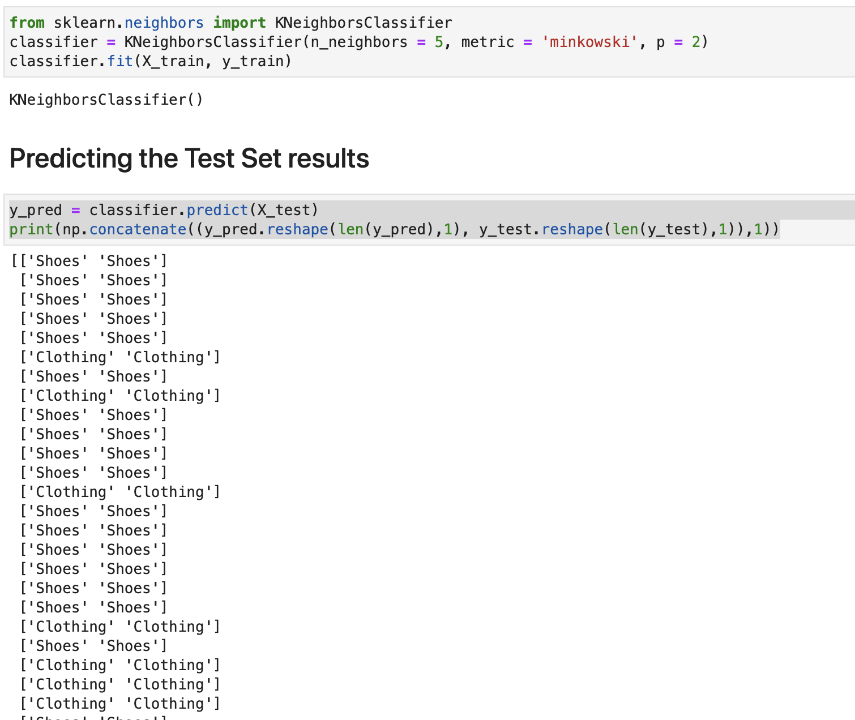
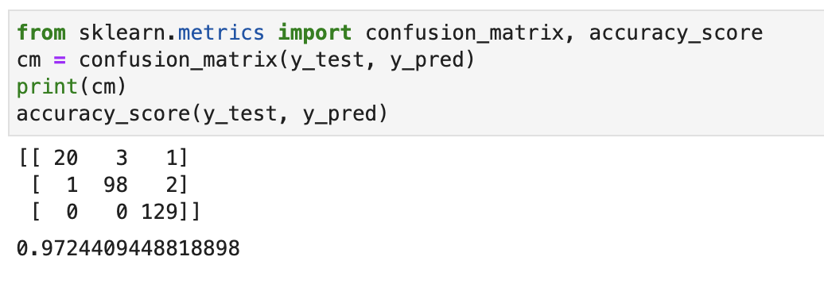
K nearest neighbour
accuracy score

Slide 14
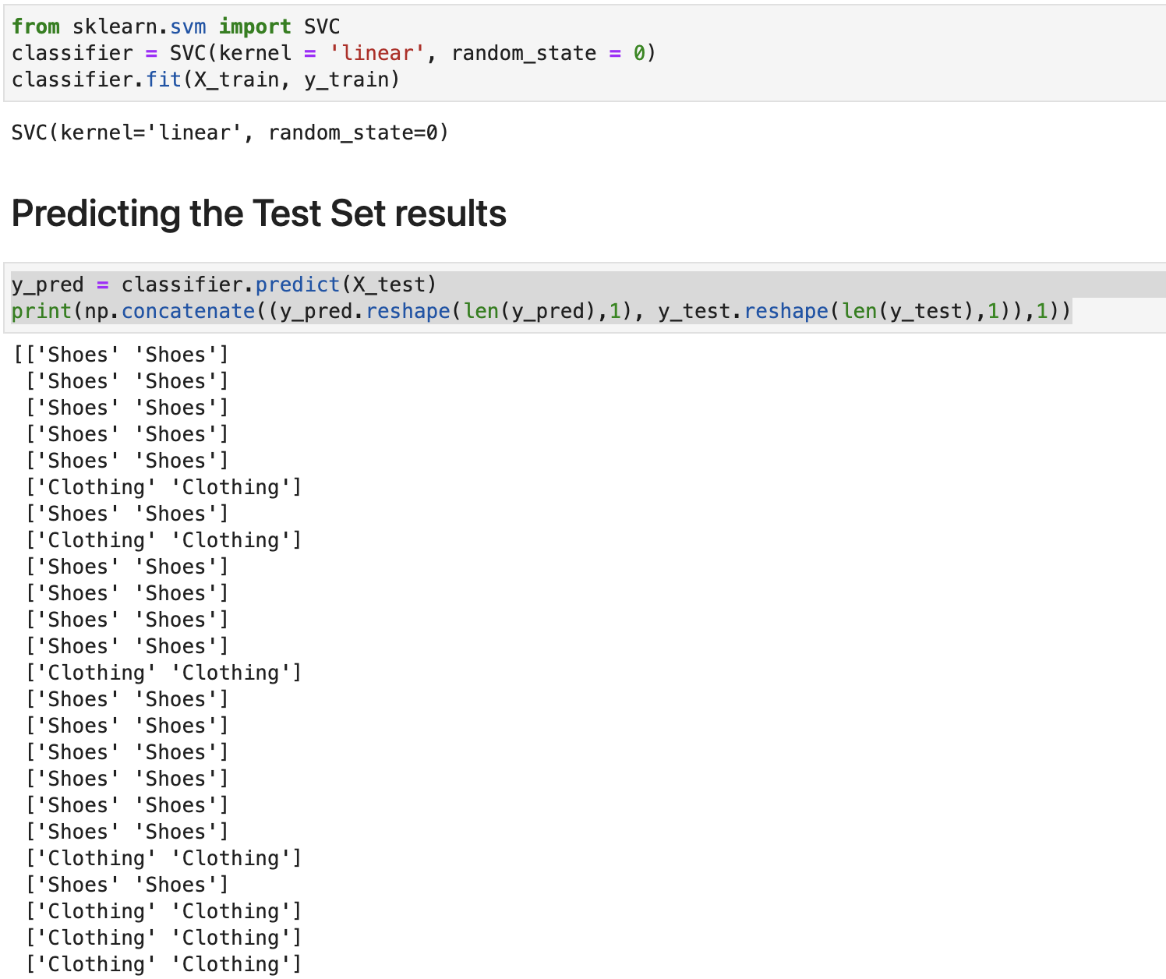
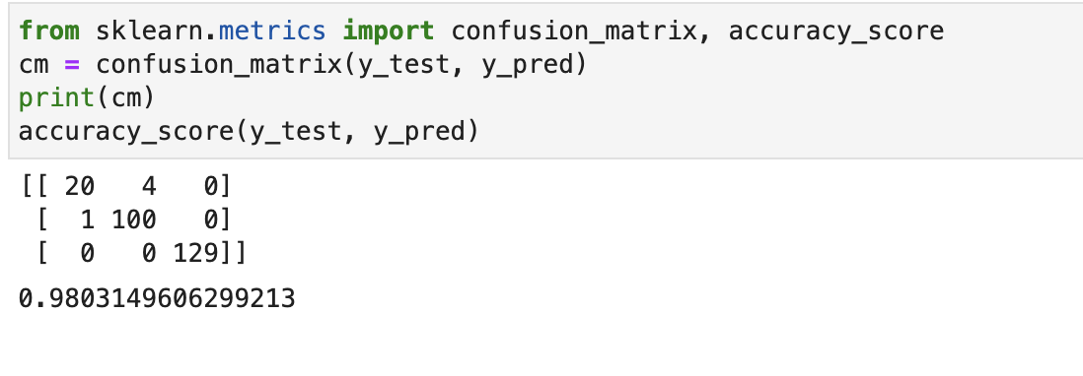
Support vector machine
Accuracy score

Slide 15
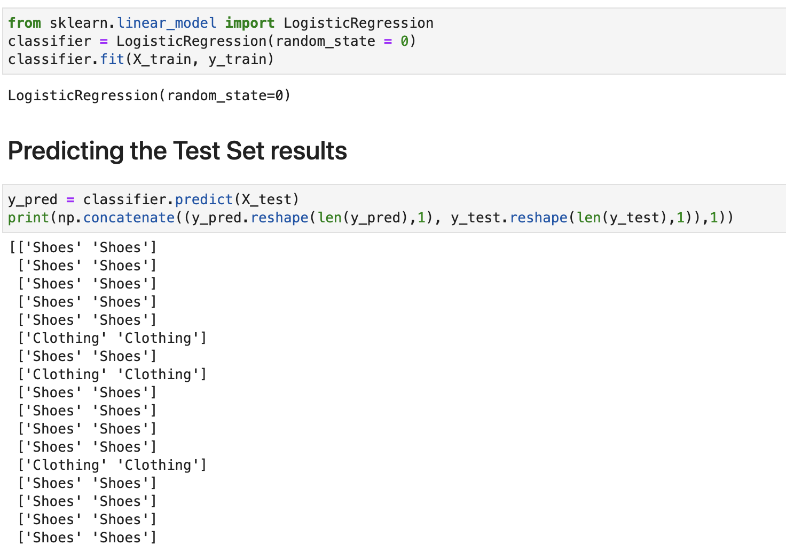
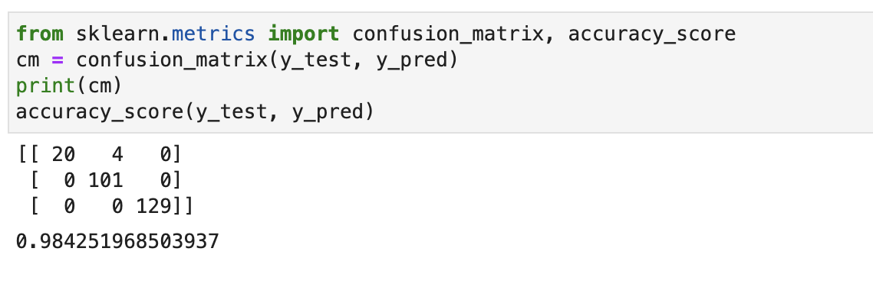
Logistic regression
Accuracy score

Slide 16
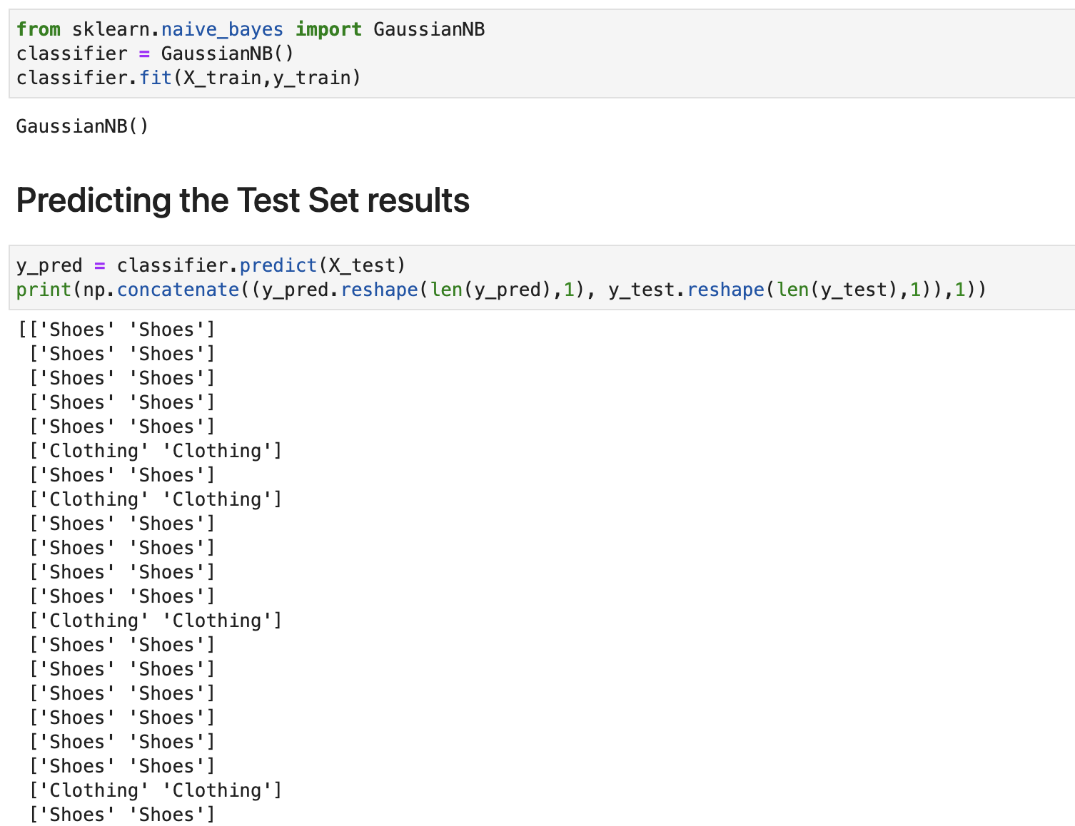
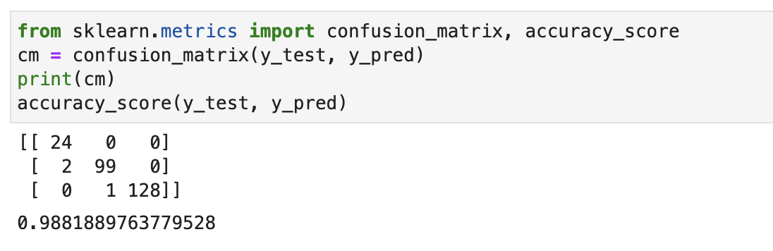
NaIve bayes
Accuracy score

Slide 17
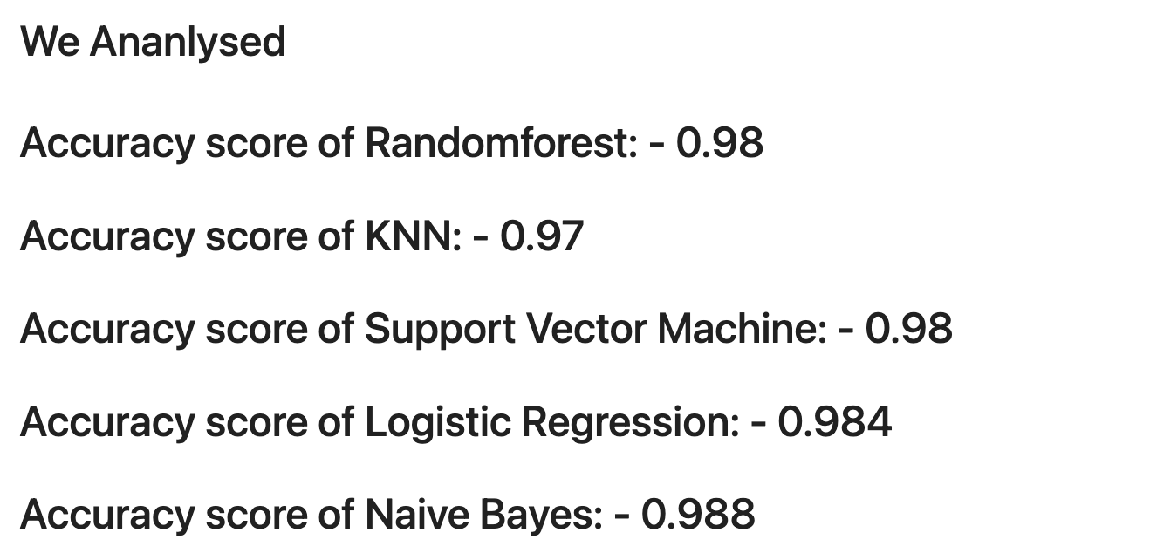
Accuracy score overall

